Slide 1
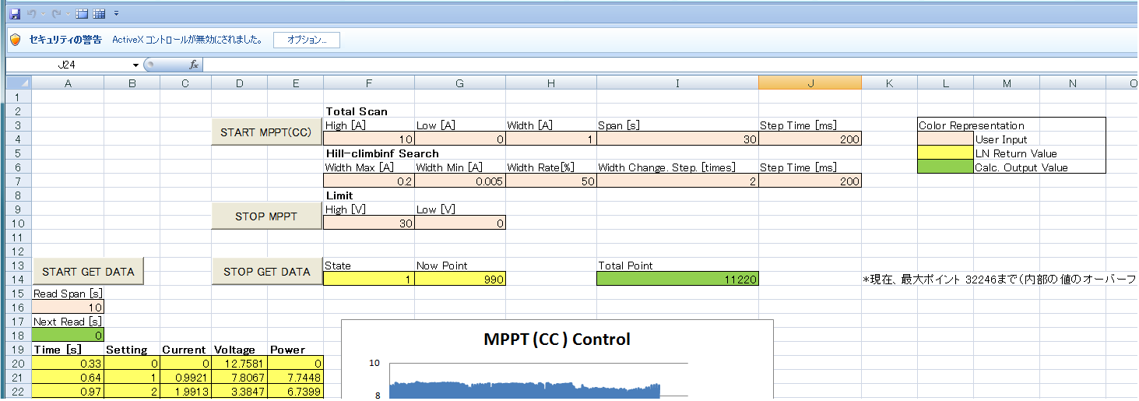
< How to use >
② Push Button to start MPPT
① input parameters
③ Push Button if you get data
④ Push Button if you stop getting data.
⑤ Push Button if you stop MPPT action

